Slide 1
Activity Diagram and Use-Case Diagram of Features of
CodeKoro - A Web-based Programming Problem Judging System

Slide 2
Activity Diagram and Use-Case Diagram of Features of
CodeKoro - A Web-based Programming Problem Judging System
Presented by: Green Chillies
Consisting the members:
ID | Name
22103397 | Nahida Ahmed Suma
22203091 | Samiya Tasnim Neha
22203097 | Md. Tanvir Ahmed Siddique
22203113 | Rume Akter
22303266 | Md Shojibur Rahman Fahad

Slide 3
Activity Diagram and Use-Case Diagram of Features of
CodeKoro - A Web-based Programming Problem Judging System
Presented by: Green Chillies
Instructed by:
Md. Rashedul Islam
Associate Professor and Coordinator
Department of Computer Science and Engineering
IUBAT – International University of Business Agriculture and Technology
December 02, 2025

Slide 4
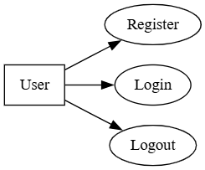
CodeKoro; Activity Diagram and Use-Case Diagrams by Green Chilies
Authentication Module: Use-Case Diagram

Slide 5
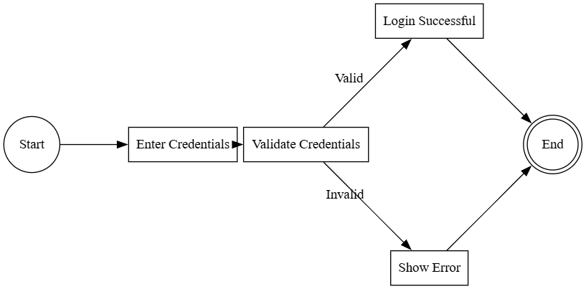
CodeKoro; Activity Diagram and Use-Case Diagrams by Green Chilies
Authentication Module: Activity Diagram

Slide 6
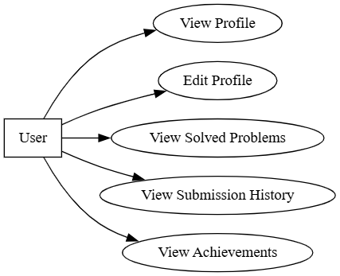
CodeKoro; Activity Diagram and Use-Case Diagrams by Green Chilies
User Profile Module: Use-Case Diagram

Slide 7
CodeKoro; Activity Diagram and Use-Case Diagrams by Green Chilies
User Profile Module: Activity Diagram

Slide 8
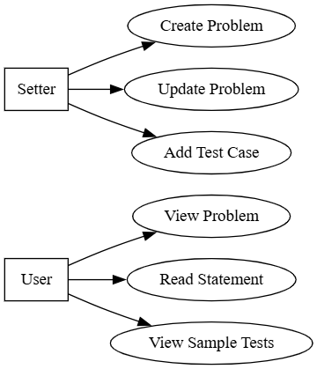
CodeKoro; Activity Diagram and Use-Case Diagrams by Green Chilies
Problem Module: Use-Case Diagram

Slide 9
CodeKoro; Activity Diagram and Use-Case Diagrams by Green Chilies
Problem Module: Activity Diagram

Slide 10
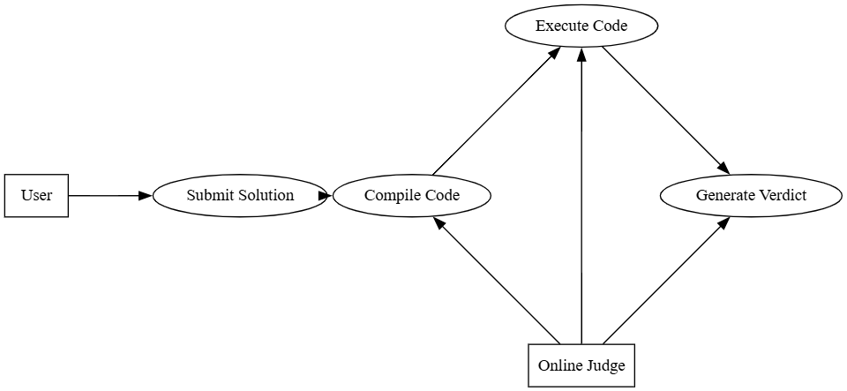
CodeKoro; Activity Diagram and Use-Case Diagrams by Green Chilies
Submission & Online Judge Module: Use-Case Diagram

Slide 11
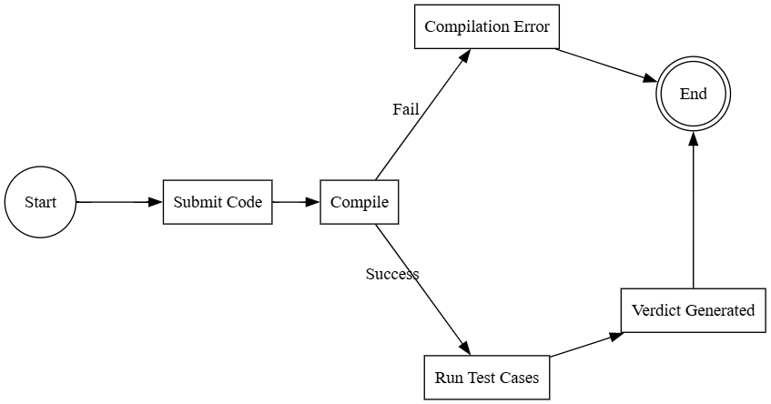
CodeKoro; Activity Diagram and Use-Case Diagrams by Green Chilies
Submission & Online Judge Module: Activity Diagram

Slide 12
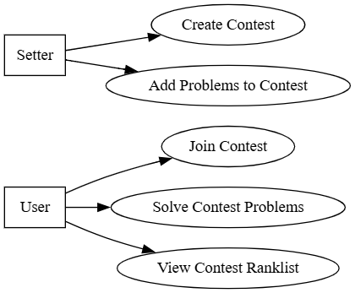
CodeKoro; Activity Diagram and Use-Case Diagrams by Green Chilies
Contest Module: Use-Case Diagram

Slide 13
CodeKoro; Activity Diagram and Use-Case Diagrams by Green Chilies
Contest Module: Activity Diagram

Slide 14
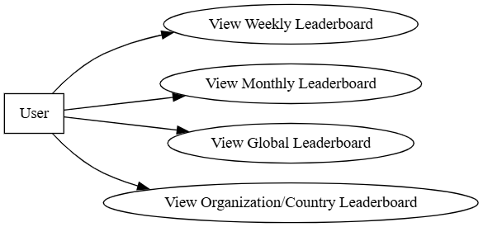
CodeKoro; Activity Diagram and Use-Case Diagrams by Green Chilies
Leaderboard Module: Use-Case Diagram

Slide 15
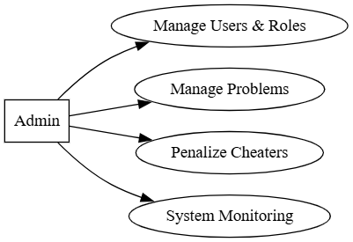
CodeKoro; Activity Diagram and Use-Case Diagrams by Green Chilies
Admin Module: Use-Case Diagram

Slide 16
Thank you.

